Slide 1
ANN Based MPPT Applied To Solar Powered Water Pumping System Using Induction Motor
Guide: Mr.Gundu Venu
BATCH-13
Somisetty Sharath Kumar-21J45A0236
Pagadala Navya Sree-20J41A0268
N.Manindra-18J41A0240
Rontala Sai Charan Reddy-21J45A0234

Slide 2
ABSTRACT
This paper deals with a PV-grid integrated system operating an induction motor (IM) coupled to a water pump. A simple DC link voltage regulation approach is adopted for the power transfer. This system is utilized to primarily feed the induction motor-driven water pump and when water pumping is not desired, the power is delivered to the utility. This system requires two current sensors and two voltage sensors in total for sensing and estimation purpose. Induction motor phase currents are estimated from DC link current by modified SVM technique. The speed estimation in this system is achieved by artificial neural network (ANN) based model reference adaptive system (MRAS) with a third order integrator for flux estimation and is capable of controlling the power flow as per demand. The field-oriented control (FOC) is used for speed control of an induction motor (IM)- pump. A third-order integrator based unit voltage generation algorithm is used to control the power transfer in both the direction between utility and the IMD with water pump by regulating DC link voltage. The appropriateness of the system is justified by simulated results on MATLAB/Simulink platform and test results procured with the help of a developed prototype during varying solar irradiances.

Slide 3
INTRODUCTION
The continuous depletion of conventional energy sources and their adverse impact on the environment are the major cause of all adversity what today’s world is facing.
In the pursuit of their replacement with renewable energy sources, photovoltaic (PV) power generation is the most popular technology that directly produces electrical power by utilizing solar energy. Conventionally, diesel engine driven water pumps have been extensively used for different purposes in the remote areas. However, nowadays the reliance on PV array operated system has increased. Generally, a PV array fed water pumping system (PVWPS) consists of three sections: solar PV array, DC-DC converter with VSI as power conversion unit, motor and pump assembly.
A PV array is the combination of a number of PV modules that are connected in series and parallel. For uninterruptible operations, a battery is linked with the PV array fed water pumping systems to store electrical energy.

Slide 4
INTRODUCTION
The battery storage requires higher maintenance cost with very less durability. Therefore, to find alternatives to this, plenty of researches have been done. There are some other PVWPSs, where the electric storage (battery) is replaced by water storage tank.
There are basically three types of control of an induction motor drive. The conventional speed control technique used for PVWPSs is scalar control.
Stability is a major issue and it also suffers from sustained adverse oscillations. Therefore, it is replaced by FOC (Field-oriented control) for this application using a reduced number of sensors.
The flux estimation plays a key role in variable frequency drive, controlled by FOC and direct torque control (DTC). The flux estimation by voltage model method is most commonly used since the stator flux is calculated by integrating the back-EMF, which eliminates the mechanical sensor.

Slide 5
PROPOSED SYSTEM
A simplified working of an ANN-based MPPT applied to a solar-powered water pumping system using a Induction motor:
Solar Panel: The solar panel generates DC power that is fed into the DC-DC boost converter.
DC-DC Boost Converter: The DC-DC boost converter increases the voltage of the DC power generated by the solar panel to a level that can be used to power the induction motor.
ANN-based MPPT algorithm: The ANN-based MPPT algorithm continuously tracks the maximum power point of the solar panel under varying environmental conditions. The algorithm takes into account various factors such as solar radiation, temperature, and load demand, and adjusts the duty cycle of the DC-DC boost converter to maintain the maximum power point.

Slide 6
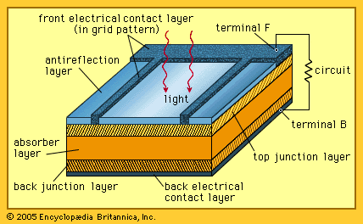
Solar Cell

Slide 7
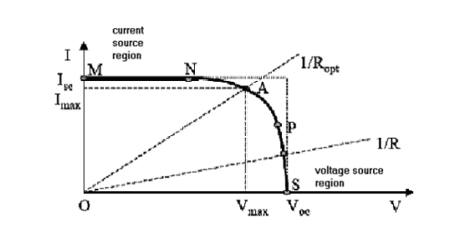
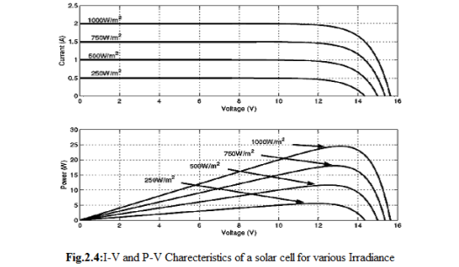
Solar Cell Characteristics
The current-to-voltage characteristic, power-to-voltage characteristics of a solar cell are non linear, which make it difficult to determine the maximum power point. It is straight forward to determine the maximum power point on a linear curve as maximum power is transferred at the midpoint of the current-voltage characteristic. A typical V-I characteristic of solar cell is shown in Figure.

Slide 8
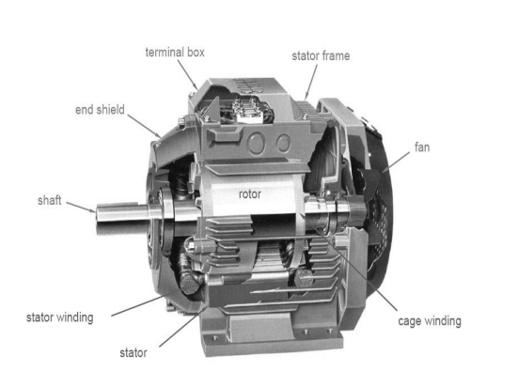
INDUCTION MOTOR GENERAL PRINCIPLE
>As a general rule, conversion of electrical power into mechanical power takes place in the rotating parts of an electrical motor. In dc motor, the electrical power is conducted directly in armature the rotating part of the motor through brush or commutates and hence dc motor called as conduction motor but in case of induction motor the motor does not receive the electrical power by conduction but by induction in exactly same way as the secondary of a 2-winding transformer receives its power from the primary.

Slide 9
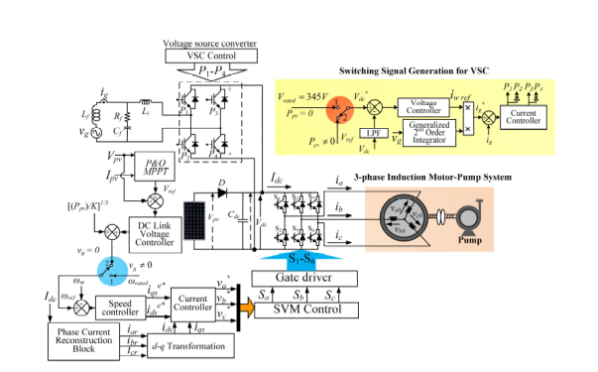
Block diagram of single-stage PV-grid based system

Slide 10

SOFTWARE REQUIREMENTS
MATLAB 2009a
SIMULINK
SIM POWER SYSTEM

Slide 11
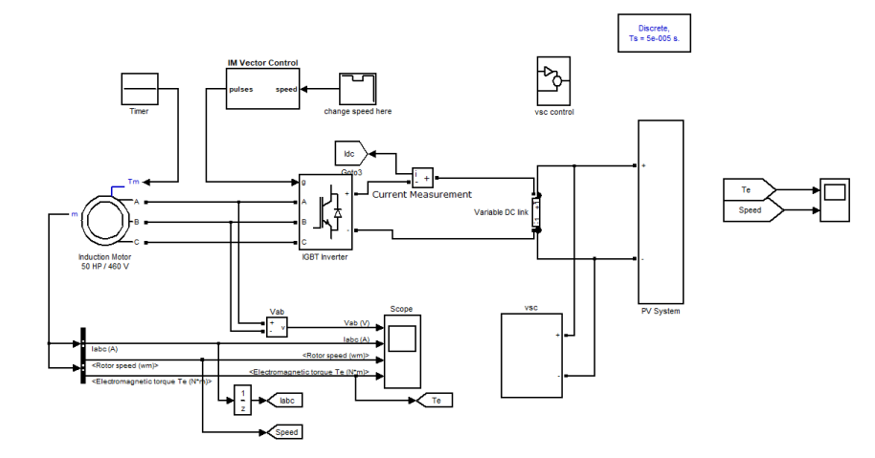
SIMULATION CIRCUIT

Slide 12
SIMULATED RESULTS
The system consisting of a 3-phase, 230 V, 1420 rpm induction motor, PV-grid energized with the peak PV voltage (Vmp) of 345 V and PV current (Imp) rating of 6.9 A, is simulated in MATLAB/Simulink environment.
Starting Behavior of System present the initial starting system response when operated by a PV array alone. This condition arises at the rated insolation level.
. Insolation Change: (1000-500) W/m2 exhibit the operation of the motor-pump system. It is observed that PV array delivers the rated power at 1000 W/m2.
Insolation Change: (500-1000) W/m2 Similar observation is made for the drive operating in insolation increment condition exhibit the performance of the motor-pump system.
Power Sharing between PV Array and Grid: (1000-500-1000) W/m2 shows the power sharing between the grid and PV array feeding the motor to operate it at rated condition.

Slide 13
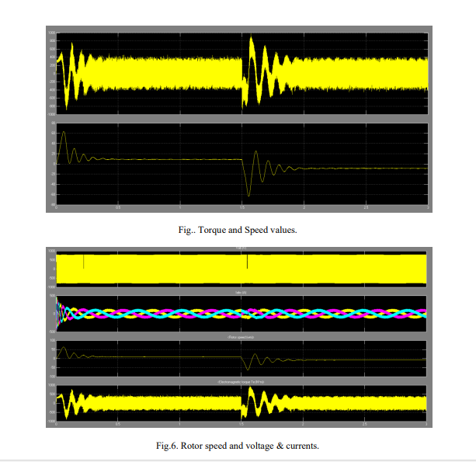

Slide 14
CONCLUSION
This new topology with bidirectional power transfer between the single-stage PV array and the grid has been modeled and implemented.
The specialty of the system is attributed in its simple power transfer capability in both the direction with an improved third-order integrator based algorithm for voltage template generation, which is insensitive to abnormalities in the grid voltage.
The mechanical sensorless control with additional feedforward flux loop has been used for its better performance in entire speed range for submersible pump, reduced number of sensors and complete utilization of pump.
The speed control of the drive and the current reconstruction have been implemented by improved SVM technique. The rearrangement of voltage vector sequences, without insertion of extra vectors, could reconstruct the current at the corner of each sector.
In addition, the grid parameters obey the IEEE-519 standard of power quality performance. This new technique with a PV array provides a practical solution for electricity generation and economic liberty for the consumer through the sale of electricity.

Slide 15


